Slide 1



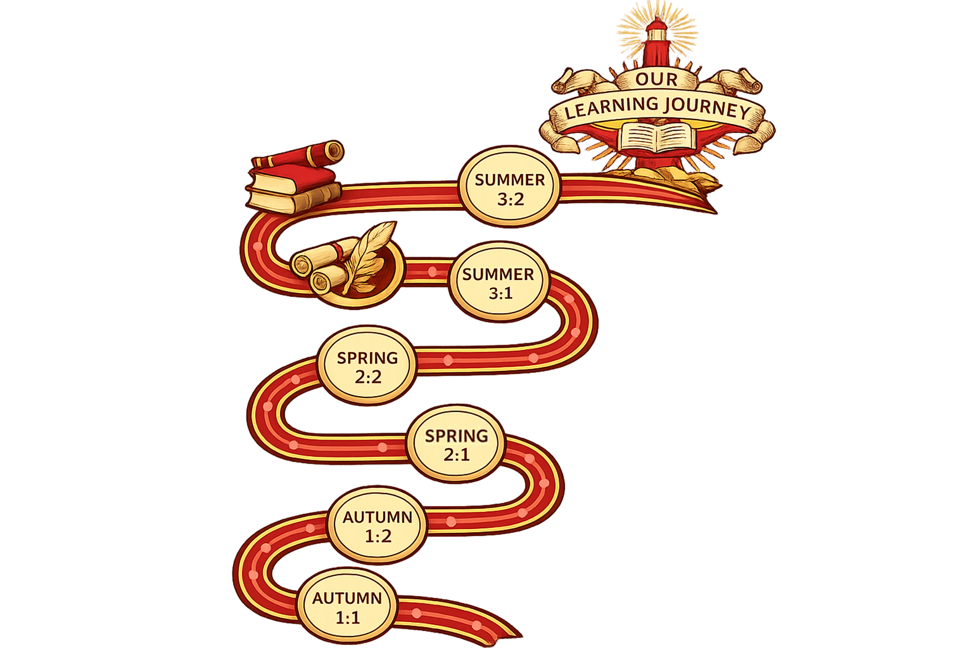

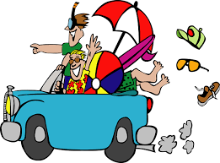





Continuation Holidays
Explain what you do on holidays. Buy drinks and snacks. Say what you would like to do. Make plans for the holidays
Grammar: use form “nous” = we of the verbs. Practise: ER verbs and verbs: “aller” = to go & “faire” = to do. Use “je voudrais + infinitive” = I would like to… Learn future tense: aller + infinitive. Time expressions.
Holidays
Explain what you do on holidays. Buy drinks and snacks. Say what you would like to do. Make plans for the holidays
Grammar: use form “nous” = we of the verbs. Practise: ER verbs and verbs: “aller” = to go & “faire” = to do. Use “je voudrais + infinitive” = I would like to… Learn future tense: aller + infinitive. Time expressions
My area
Describe your town. Ask & give directions. Say where you want to go.
Grammar: Learn “il y a” = there is/ are; verbs: “aller” = to go in present; “pouvoir” (can) ” + infinitive / “vouloir” (want) + infinitive. “on peut + infinitive” = we can. Use à + article; re-cap: giving opinions.
My hobbies
Explain what you do in your spare time, give opinions, say what sports you practise and talk about the weather
Grammar: Learn verbs in the present: ER verbs and jouer = to play & faire = to do sports; using verbs to give opinions: aimer= to like/ detester= to hate/ adorer= to love.
My school
Explain which subjects you study
Give opinions about school subjects. Describe your school timetable and say what eat at break time
Grammar: Ask questions, Using verbs of opinion, connectives, intensifiers (very, quite, a bit, etc). Be able to tell the time.
Introducing myself
Talk about what I and other people likes/ dislikes. Say what you have in your school bag. Describe yourself. Greet people.
Learn pronunciation of French letters and sounds
Grammar: learning about French adjectives: masculine/ feminine; how to say I am; he/she is my name is; numbers; verbs in the present: ER verbs and “avoir= to have; être= to be »

Slide 2



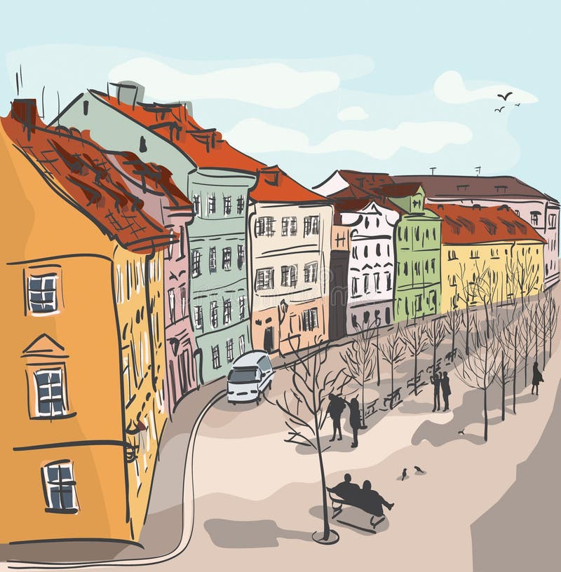



My qualities: talents and ambitions for the future
Talk about talent & ambitions. Give instructions. Explaining who is the best; the most; the least, etc.
Grammar: use the imperative to give instructions. Practise verbs followed by an infinitive: pouvoir = can, vouloir = want & devoir = must/ should. Learn how to use superlatives: is the best; the most; the least, etc.
Where I live: town and home
Describe where you live. Talk about your house. Discuss what you eat and what food you buy.
Grammar: Using adjectives correctly: irregular adjectives. Practise comparatives: plus/ moins…que – more/ less..than. Use “il faut + infinitive”. Practise the 3 tenses: present, past & future.
My identity: personality and relationships
Discuss personality & relationships. Be able to agree/ disagree and justify your opinions. Talk about clothes and your passions. Describe where you live.
Grammar: Using adjectives correctly: mas/ fem. Learn to use reflexive verbs to explain relationships I get on well with, I argue, etc ) and learn the future tense.
Holidays in Paris
Talk about what past holidays: say what you did in the last holidays. Give opinions on the last holidays. Understanding tourist info.
Grammar: use verbs in the past tense regular & irregular. Practise the use of present & past together in sentences and/ or a short text.
Free time: books, films and TV
Talking about TV, cinema & reading. Say what you use internet for. Explain what you did yesterday.
Grammar: practise verbs in present tense regular verbs, use verb: avoir= to have, être= to be, aller= to go & faire= to do, Learn verbs in the past.

Slide 3




Youth rights and world events
Learn about schools in different countries. Talk about what jobs people do. Discuss how to tackle hunger in the world. Discuss religion in France.
Grammar: Practise possessive adjectives: mon/ma/mes= my, etc. Use of reflexive verbs (verbs which need a pronoun). Use “on peut + infinitive” = one can…
Describe other people
Describe people’s character and express opinions on other character.
Grammar: use correctly adjectives. Practise the perfect tense with “avoir” and “être”
Travelling around France
Discover French regions. Make travel arrangements: buying tickets, asking for tourist information, booking a room and visiting tourist attractions.
Grammar: revise verbs in imperative used to give & understand instructions/ advice, Use of pronoun “y” = there: e.g. we’ll go there by train. Use “je voudrais + infinitive = I would like to… to make bookings.
Healthy lifestyles
Talk about illness; give and understand advice on health. Explain what you do to keep fit.
Grammar: Use “j’ai/ tu as/ il a mal à = to say something hurts. Use negatives sentences: “jamais= never; ne..plus= not anymore, etc”. Use verbs in imperative to give instructions/ advice: e.g. mangez= eat; faites = do.
Future plans
Explain what you are going to do. Make plans for the future. Talk about future careers and the importance of learning languages.
Grammar: use of “on= we” form of the verb. Learn the future tense: “aller + infinitive = going to …”. Make plans usign “je peux = I can; je veux = I want; je dois = I must + verb in infinitive”.
TV, cinema, reading and free time
Say what you watch in the TV or cinema and express opinions. Say what you like to read and why.
Grammar: Practise verbs in the present and past; use adjectives accurately: mas-fem, sing-plural; word order. Practise verb “aller” = to go.

Slide 4

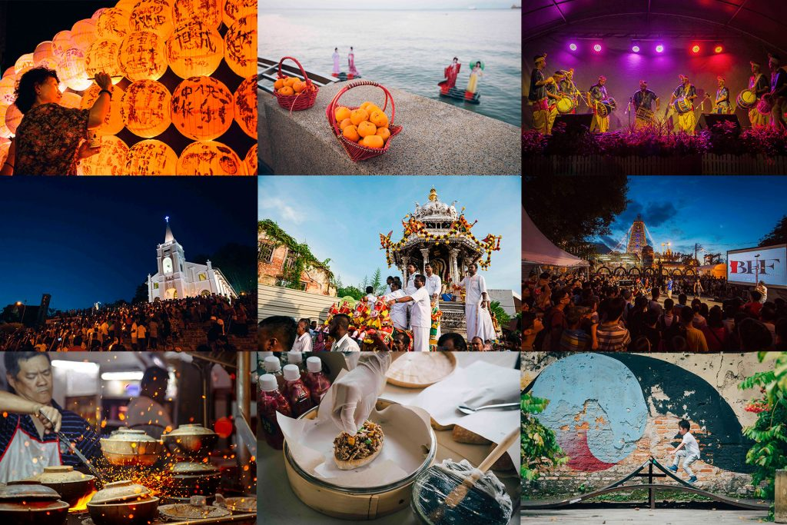

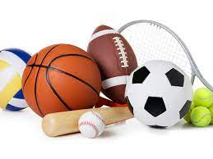

Customs, festivals and celebrations
Describe and give opinions on festivals and celebrations with friends & family. Talk about festivals and traditions in different countries. Discuss what we eat on special occasions. Learn about famous festivals.
Grammar: Revise present tense of irregular verbs. Direct object pronous (it/ them). Use of the imperfect tense. Using “y” and “en”
e.g.: J’y vais= I go there. Future tense of irregular verbs. Complex sentences suing que/ qui = which; quand= when; où= where
Celebrity culture
Express opinions on celebrities and discuss advantages and disadvantages of being famous. Discuss how and why people might become famous. Talk about personal ambitions. Discuss celebrities on social media. Learn about famous French speakers.
Grammar: Rules of imperative. Practise the conditional. Re-cap: present of irregular verbs possessive adjectives (my, your, etc); perfect tense and use of time expressions “il y a” & “depuis”.
Free Time
Describe free time activities you did giving detail. Talk about TV, cinema and music preferences. Express opinions on free time activities. Refer to events involving famous people. Discuss extreme sports and sporting events.
Grammar: Perfect tense with “avoir” and with “être” including irregular. Use reflexive verbs in the present (verbs which need a pronoun). Use “en” and “à” with places. Agreement with direct object pronouns
Education and work
Give opinions on school subjects. Talk about post-16 education & plans for the future. Describe your dream school. Refer to ideal job and ambitions. Describe work experience. Learn about places of pilgrimages and sacred sites.
Grammar: Negative constructions. Use conditional: should. Superlative adjectives: the most/ least, etc. Use “il y a” =there is and “il y aura” = there will be. Learn “être en train de + infinitive” = to be doing something. Adverbs of quantity. Practise all the grammar leant up to now.
Healthy living and lifestyle
Describe health problems and addictions. Reasons to stay healthy and risks of not being. Compare present lifestyle and future intentions. Explain what you do and did to keep fit. Talk about physical and mental well-being.
Grammar: near future. Plural pronouns. Using 2 tenses together. Avant de + infinitive = before doing something. Impersonal expressions: one..; doing.., etc.
Myself, family, relationships and future plans
Describe a person’s character and personality. Express plans for the future. Talk about types of partnership and relationships with friends.. Talk about family members and different types of family.
Grammar: revision of the basics. Re-cap use & apply rules of present tense, past tense and future tense, including irregular verbs. Use adjectives accurately , including comparative adjectives: plus/ moins que = more/ less than…. Impersonal verbs ( one + verbs)
Baseline assessment

Slide 5






Exam preparation: reading, listening and writing
Vocabulary and verbs learning/ memorising
Listening, reading and writing skills.
Speaking Exam preparation
Act on advice received after Speaking mock exam to improve in final Speaking exam.
Revision / reinforcement of vocab. Grammar.
Preparation for final exams
GCSE speaking exam: end of April/ beginning May 2027
Exam skills
Listening and Reading: increase vocabulary learning & practise. Practise reading and listening skills, & exam type questions
Speaking mock preparation
Practise exam skills: understand all tasks
Speaking : PREPARE the different tasks:
Role play task: understand task and practise.
Reading aloud + 2 short unprepared questions.
Photos description + follow up conversation.
Practise model answers for general conversation.
Speaking mock exam: March 2027
The environment & where people live
Discuss environmental issues. Look at local environment. Describe your town & your ideal town.
Grammar: Revise infinitives used as nouns. Negatives. Revise modal verbs in the present tense. Recap condition tense: would….
Mock exam.
Media & Technology
Describe the world pre/ post internet. Talk about how we use technology and how our use has changed. Discuss pros & cons of the digital age.
Grammar: Revise present tense. Modal verbs in perfect tense. Use a wide range of different tenses. Recognise & use imperative.
Mock exam: listening, reading and writing past paper
Travel & Tourism, and places of interest
Discover French speaking islands; describe a dream holiday and write a holiday blog. Describe a mayor French town.
Grammar: Revise and practise tenses to be able to use them with confidence. Re-cap adjectival agreement. Use of pour + infinitive & sans + infinitive. Revise prepositions dans/ en
Baseline assessment: writing paper

