Slide 1



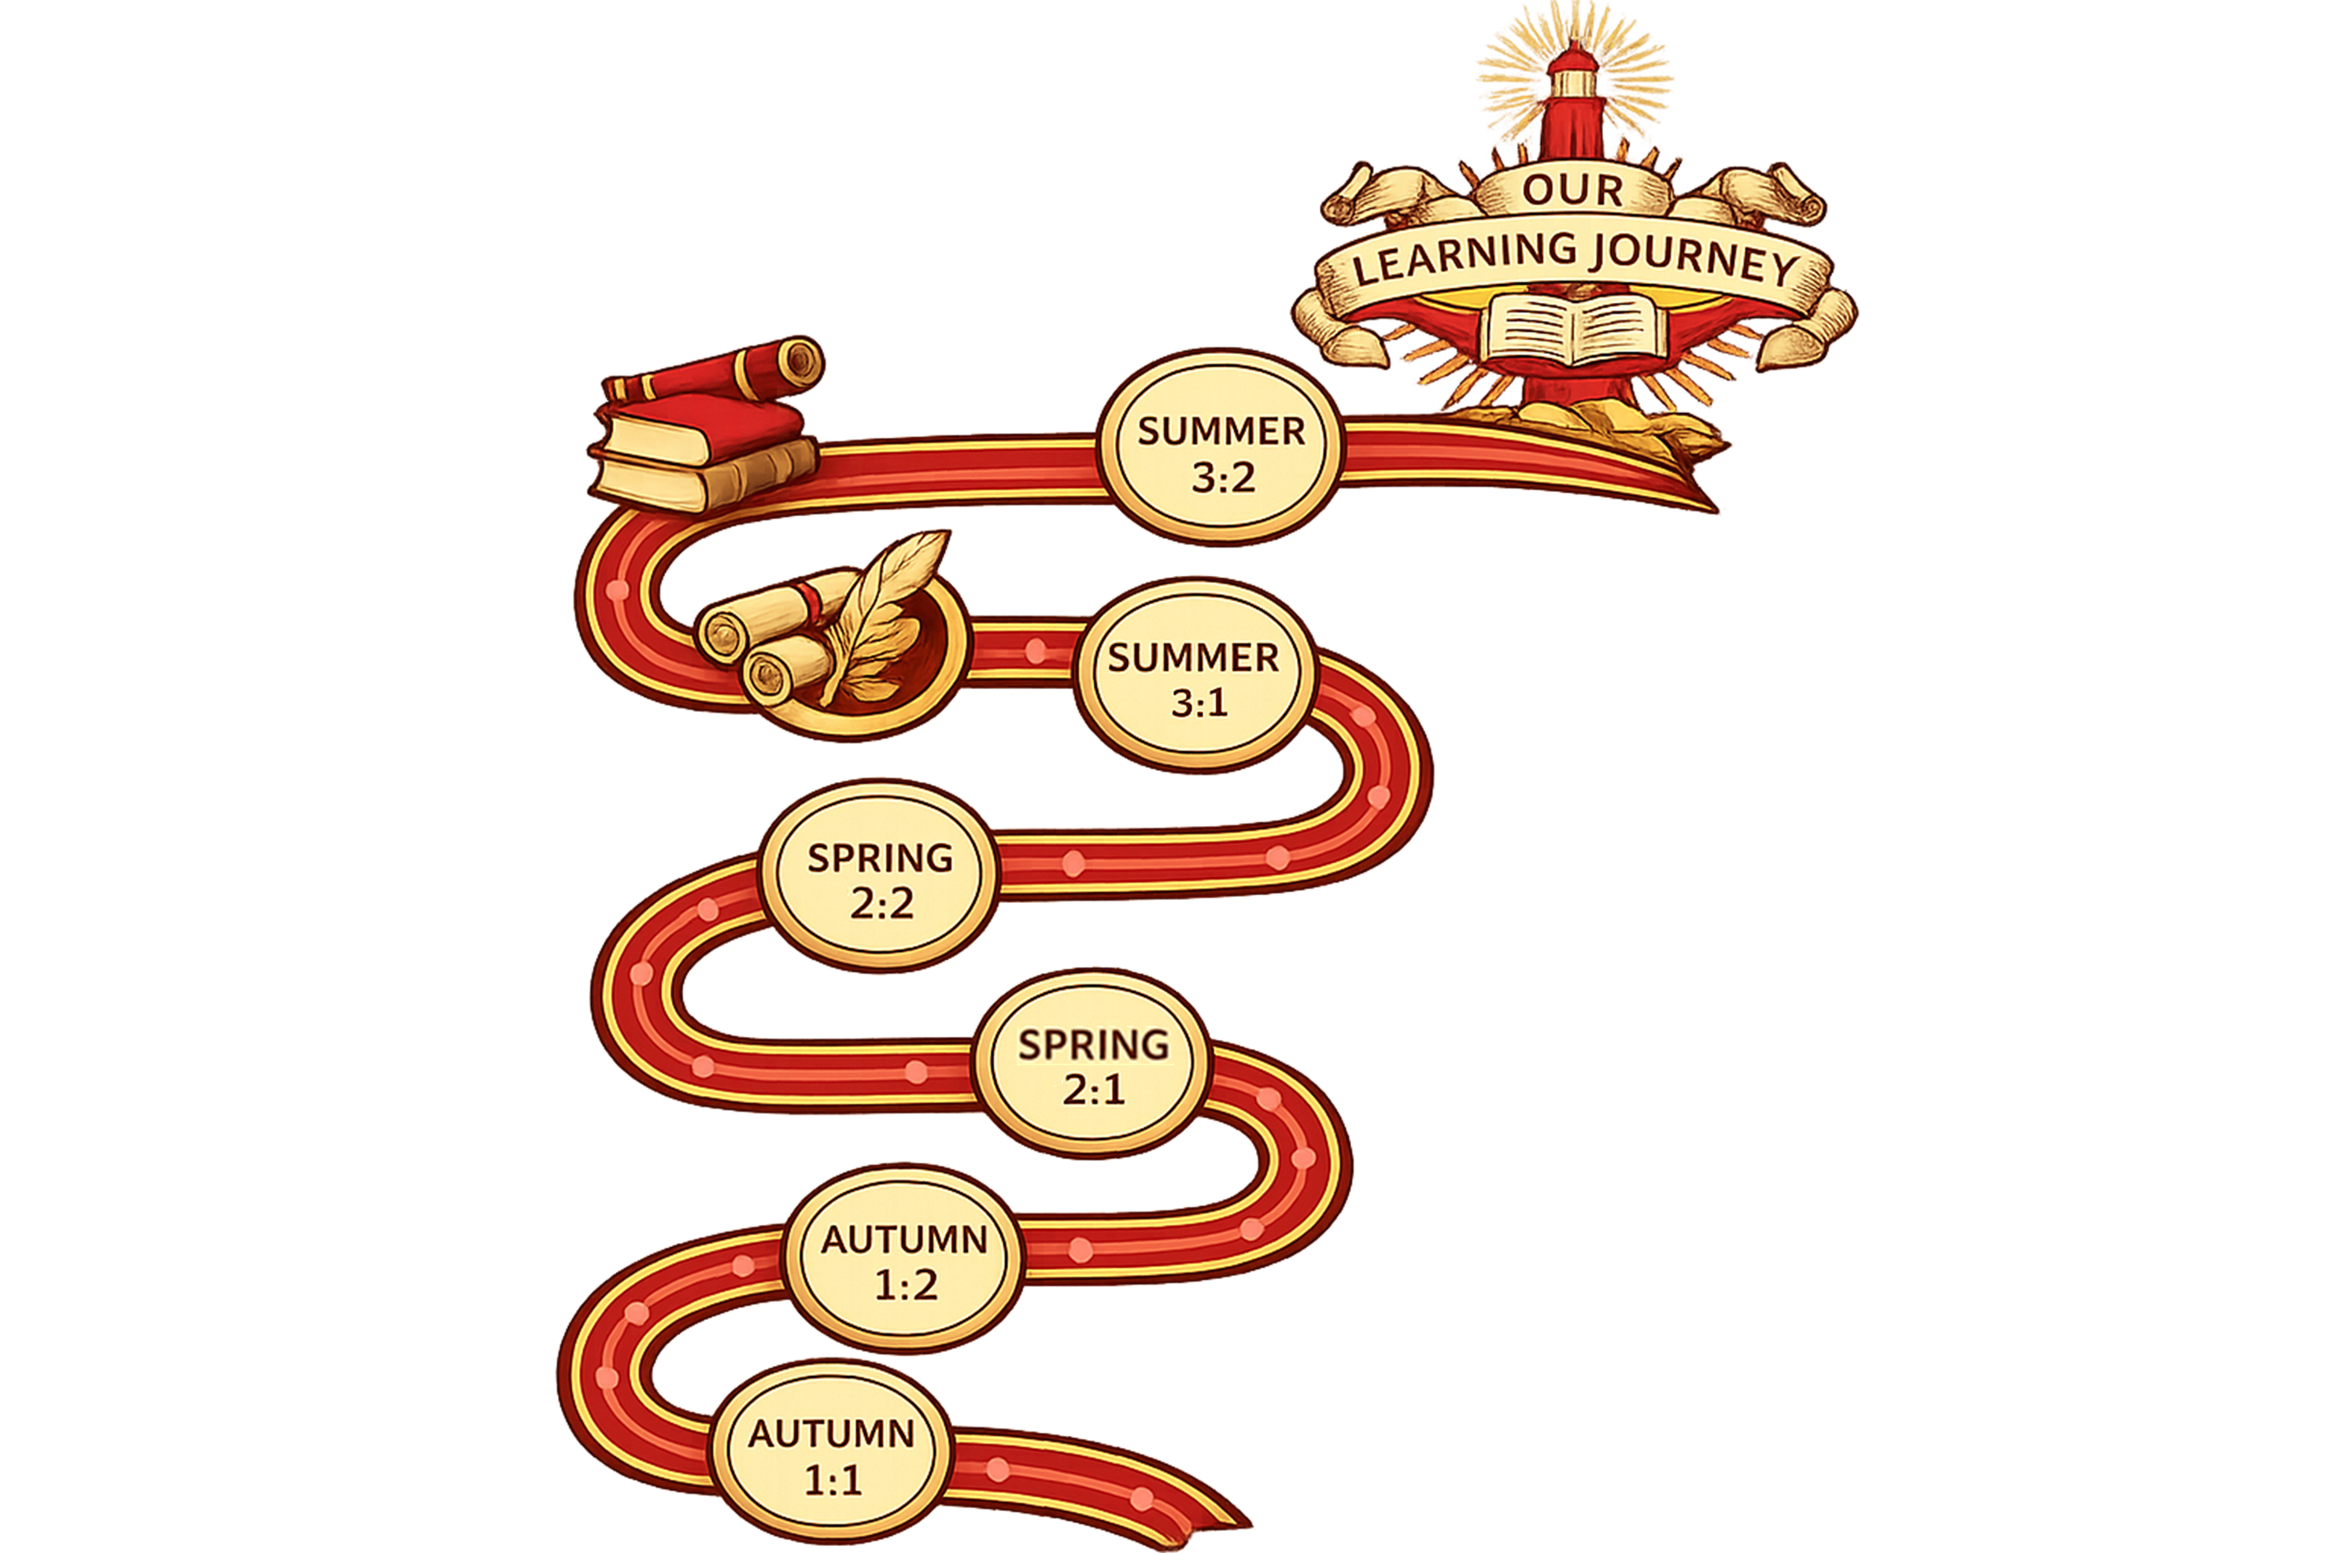
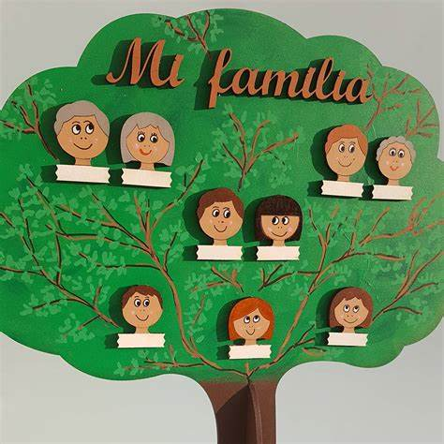

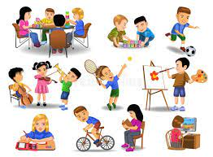

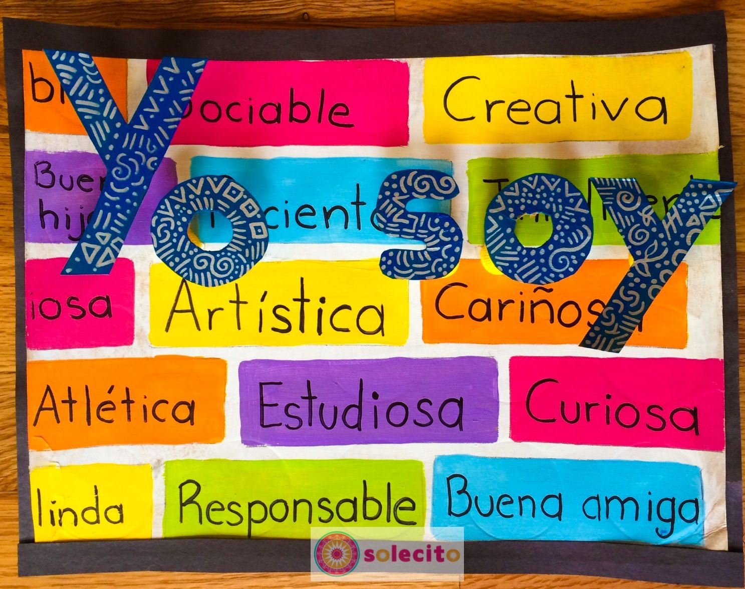


Continuation My family & friends
Describing your family. Describing yourself and other physically : hair and eyes, and character. Describing where you live.
Grammar: Learn Possessive adjectives: mi/tu, etc = my, yours, etc. Numbers 20-100. Present tense verbs “ser” (to be) and « tener » (to have). Using intesifiers : « muy (very) ; bastante (quite) and un poco (a bit) when writing sentences.
My family & friends
Describing your family. Describing yourself and other physically : hair and eyes, and character. Describing where you live.
Grammar: Learn Possessive adjectives: mi/tu, etc = my, yours, etc. Numbers 20-100. Present tense verbs “ser” (to be) and « tener » (to have). Using intesifiers : « muy (very) ; bastante (quite) and un poco (a bit) when writing sentences.
My school
Explain which subjects you study
Give opinions about school subjects and teachers. Describe your school facilities.
Grammar: learn verbs in the present: e.g. I study; I eat; I talk, I drink and also use “hay + un/una= there is/ are.
Continuation Free Time:
Say what you do in your free time and when. Express opinions on free time activities.
Grammar: verbs in the present to say what activities/ sports you do. Use opinions correctly. Longer sentences using connectives and time expressions.
Free Time:
Re-cap and practise previous learning.
Say what you do in your free time and when. Express opinions on free time activities.
Grammar: verbs in the present to say what activities/ sports you do. Use opinions correctly. Longer sentences using connectives and time expressions.
Introducing myself
Learn how to greet people. Give information about myself: describe my personality, say my name& age. Talk about family members
Learn pronunciation of Spanish letters and sounds
Grammar: learning about Spanish adjectives: masculine/ feminine. Verbs: I am; you are; he/ she is. I have; he/she has.

Slide 2

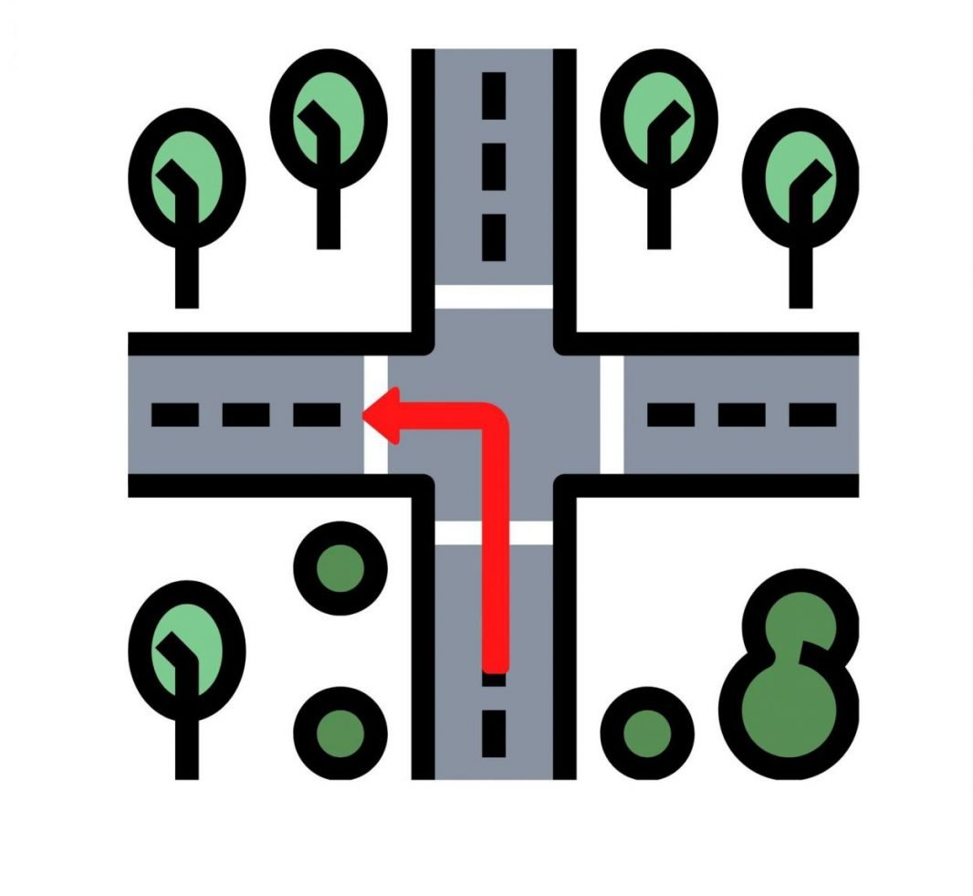

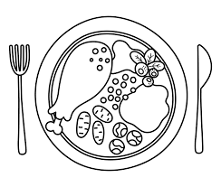

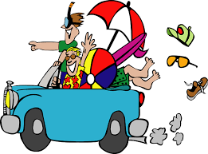
Going out
Arranging to go out. Making excuses not to go out. Talking about daily routine. Clothing: describing what you wear/ wore.
Grammar: Use: Me gustaría + infi. Learn location. Use al/ a la . Irregular verbs poder= can & querer=want. Use verbs of daily routine. Use este/ esta/ estos/ estas. Revise present, past and future.
Continuation: Let’s eat
Explain which food you like/ dislike. Describe what you eat at mealtimes. Say what you are going to buy for a party.
Grammar: Use of plural opinions. Asking questions. Verbs in the present Tense: learn endings regular AR/ER/IR verbs. Structures to order food and talk about food. Future tense: ir + a+ infinitive. .
Let’s eat
Explain which food you like/ dislike. Describe what you eat at mealtimes. Say what you are going to buy for a party.
Grammar: Use of plural opinions. Asking questions. Verbs in the present Tense: learn endings regular AR/ER/IR verbs. Structures to order food and talk about food. Future tense: ir + a+ infinitive.
Continuation: Technology and TV in my life
Say what you use your mobile phone for. Explain which TV programmes you prefer and why. Tell what you did yesterday.
Grammar: Revise present regular verbs & past tense. Time expressions o (normally/ sometimes, etc). Comparatives: más/ menos..que= more/less..than . Past tense “hacer = to do ( I did = hice) ”.
Technology and TV in my life
Say what you use your mobile phone for. Explain which TV programmes you prefer and why. Tell what you did yesterday.
Grammar: Revise present regular verbs & past tense. Time expressions o (normally/ sometimes, etc). Comparatives: más/ menos..que= more/less..than . Past tense “hacer = to do ( I did = hice) ”.
Past holidays
Talk about past holidays. Say what you did in the last holidays. Give opinion on the last holidays.
Grammar: Past tense AR/ ER/ IR regular verbs + irregular verbs: fui = I went; and It was = fue. Asking questions in the past. Time expressions in the past/ present.

Slide 3




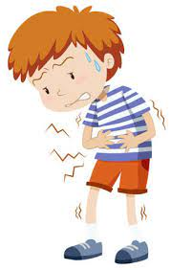



My city / My house
Describe your city and your house. Talk about environmental issues.
Grammar: Revise present: regular and irregular verbs and practise future tense; make wishes for the future using: “me gustaría/ encantaría + infinitive= I would like”. Revision use of hay / no hay (there is/ there isn’t)
School
Give opinions on subjects, teachers, etc. & justify. Describe school facilities. Talk about problems and rules. Explain what after school activities you do/ will do.
Grammar: Use adjectives; re-cap: use complex opinions & explain why; apply rules comparatives (more/less..than…) / superlatives (the most/ least). Use negatives and structures with infinitive. Pronouns. Re-cap apply rules of tenses: present and future.
Healthy lifestyles
Talk about illness; give and understand advice on health & healthy living. Discuss healthy and unhealthy eating.
Grammar: Use “me duele” + body part= to say something hurts. Use “(no) hay que + infinitive & (no) debes + infinitive= one must” to give advice. Learn when to use verbs ser & estar (both meaning to be). Use direct pronouns: e.g. las como = I eat them. Continue practising use of tenses: present , past and future
Continuation: Helping at home, work and future plans
Say what you do at home to help. Express what you would like to do as a job and explain your personal qualities. Make plans for the future.
Grammar: Revise present: regular and irregular verbs; make wishes for the future using: “me gustaría/ encantaría + infinitive= I would like”. Future tense (I will….)
Helping at home, work and future plans
Say what you do at home to help. Express what you would like to do as a job and explain your personal qualities. Make plans for the future.
Grammar: Revise present: regular and irregular verbs; make wishes for the future using: “me gustaría/ encantaría + infinitive= I would like”. Future tense (I will….)
Technology , TV, cinema and free time
Say what you use technology for, give opinions and compare types of TV programmes and films. Justify your opinions
Grammar: Revise regular verbs in present & past: AR/ER/IR verbs. Use plural opinions & adjectives. Use of comparatives (more…than / less…than). Future tense: ir + a + infinitive.

Slide 4

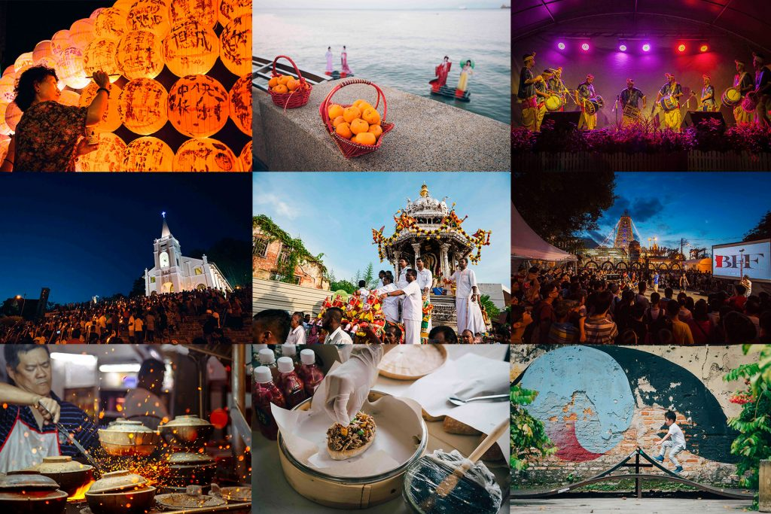


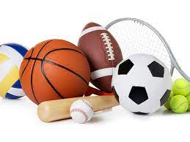
Customs, festivals and celebrations
Talk about religious celebrations. Discuss family traditions and festivals in Latino America. Find out about traditional Hispanic music and dance.
Grammar: past tense of irregular verbs. Past tense time expressions (ayer= yesterday; la semana pasada= last week; etc). Complex expressions of time: Antes de + infinitive = before… / Después de + infinitive = after…/ al + infinitive = on/ upon …(e.g. al llegar = on arriving)
Celebrity culture
Comparing two female icons. Discuss celebrity culture. Debate celebrities as role models. Talk about the pros & cons of fame.
Grammar learn how to form and use imperfect. Complex sentences using three tenses together. Using adjectives with “ser” and “estar” (both meaning to be). Understand the difference: preterite and imperfect (both to talk about the past). Use of: Soler + infinitive= to talk about what we usually do.
Education and work
Talk about school facilities and rules. Discuss positive and negative aspects of school: give and justify opinions. Recognise positive & negative opinions. Talk about jobs and describe your ideal job. Discuss how to look for a job, give advice on what to do in an interview. Say what you will do. Talk about cultural aspects of Spanish speaking countries: siesta= nap; popular sports; live in neighbourhoods
Grammar: Negative constructions: nada= nothing; nadie=nobody; nunca=never. Use of comparative más/ menos … que= more/less..than and superlative adjectives: el mejor = the best/ el peor = the worst. Use correctly verbs of opinion: me/te/le/ nos… gusta/ gustan. Complex negatives.Verbs followed by infinitive. Lo + adjective: e.g. lo bueno = the good thing. Future tense: infinitive + é/ás/á/emos/án = I/you/he/we will….
Free time
Talk about free time activities & extreme sports. Describe daily routine and what we wear. Expand your sentences about what you do. Talk about TV, cinema and music preferences. Talk about unusual hobbies.
Grammar: estar + gerund= to be doing something; Verbs with infinitive: prefiero/ suelo + infi. Verbs to talk about daily routine. Complex verbs with a preposition + infinitive. Adjectives: este (a)/ese (a)/aquel/aquella= this/that/those. Past tense regular verbs and “ver” & “ir”. Time expressions. Revise superlatives (the most/least)
Healthy living and lifestyle
Explain what you do to keep fit and look after your health. Talk about what type of diet you have and what you are going to do to improve it. Discuss Spanish lifestyle.
Grammar: Verbs followed by infinitive. Expressions using the verb “tener”.(tener frío= to be cold/ tener sed= to be thirsty, etc). Understand question words. Future tense: ir + a + infinitive. Verbs used to give health advice: tener que / deber/ hay que/ se debe + infinitive. Adjectives of nationality
Myself, family and friends
Describe a person’s character and personality. Describe what people look like. Talk about relationships with friends Talk about family members and different types of family.
Grammar: Present tense of regular verbs and irregular: “tener/ dar/salir/ ir/ decir”. Use adjectives correctly: mas-fem, sing-plural. Possessive adjectives: mi/tu/su= my/ your/ his/her. Present of reflexive verbs (verbs which need a pronoun. Linking words (connectives.
Baseline assessment

Slide 5

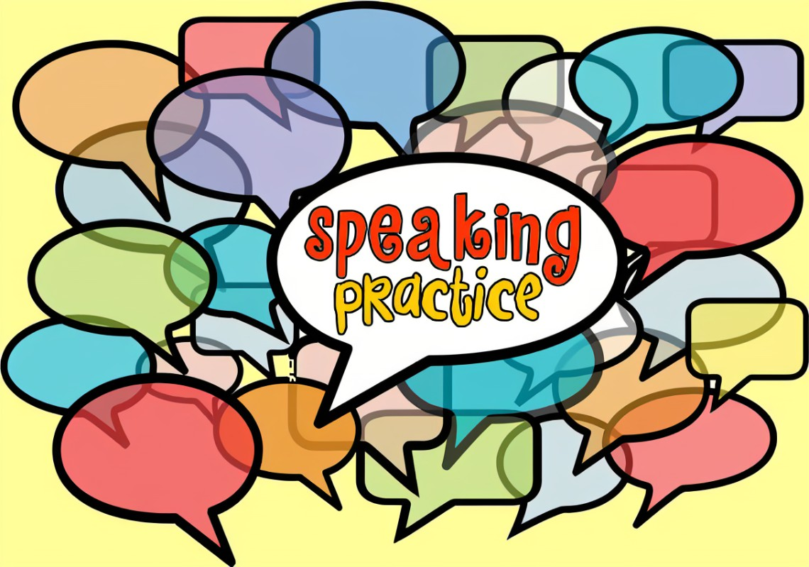


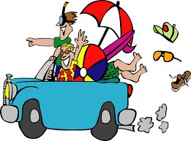
Exam preparation: : reading, listening and writing
Vocabulary and verbs learning/ memorising
Listening, reading and writing skills.
Speaking Exam preparation
Act on advice received after Speaking mock exam to improve in final Speaking exam.
Revision / reinforcement of vocab. Grammar.
Preparation for final exams
GCSE speaking exam: end of April/ beginning May 2027
Exam skills
Listening and Reading: increase vocabulary learning & practise. Practise reading and listening skills, & exam type questions
Speaking mock preparation
Practise exam skills: understand all tasks
Speaking : PREPARE the different tasks:
Role play task: understand task and practise.
Reading aloud + 2 short unprepared questions.
Photos description + follow up conversation.
Practise model answers for general conversation.
Speaking mock exam: March 2027
The environment & where people live
Describe the house. Describe your town & area. The weather. Discuss environmental issues. Helping the environment. Look at local environment. Describe your town & your ideal town. Give instructions or advice
Grammar: adverbs of place: e.g. far from/ behind / near, etc. Revise preterito perfecto. Use of estar + participle: e.g. está limpio= it’s clean. Use of imperative to give advice or instructions. Use of “acabar de + infinitive = to have just done something.
Mock exam.
Media & Technology
Social networks. Talk about technology has changed. Discuss pros & cons of the digital age. Advantages & disadvantages of social media. Gadgets, mobiles & apps. Justifying and giving reasons: make it more complex.
Technology of the future.
Grammar: Preterito perfecto. Lo+ adjective + de es que… Revise past tense and time expressions. Revie object pronous.
Mock exam: listening, reading and writing past paper
Travel & Tourism, and places of interest
Talk about transport & holiday activities. Making recommendations. Talk about problems while on holidays. Discuss what type of holidays we prefer.
Grammar: Re-cap of all the tenses. conditional tense: I would.. Revision past tense. Possessive pronouns: el mío = mine, etc. Object pronouns: lo/la = it. Use of se + 3rd person of the verb. E.g. se habla inglés = English is spoken. Verbs to recommend something: tienes que / hay que/ debes/ vale la pena / recomiendo + infinitive.
Baseline assessment: writing paper

